Slide 1
Chapter 15
Floating and Positioning

Slide 2
Normal Flow
Text elements are laid out from top to bottom in the order in which they appear in the source, and then from left to right.
Block elements stack up on top of one another and fill the available width of the browser window or other containing element.
Inline elements and text characters line up to one another to fill block elements.

Slide 3
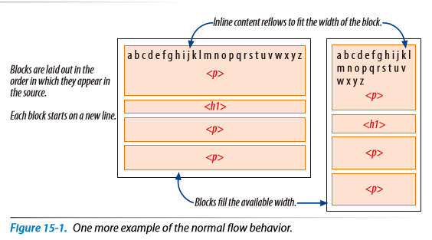
Normal Flow Behavior

Slide 4
Float vs. position
Floating an element moves it to the left or right, allowing the following text to wrap around it.
Positioning is a way to specify the location of an element anywhere on the page.
Normal flow is top to bottom, left to right

Slide 5
float
Primary tool in modern CSS-based web design
Used to create multicolumn layouts
Navigation toolbars from lists
Table-like alignment without tables

Slide 6
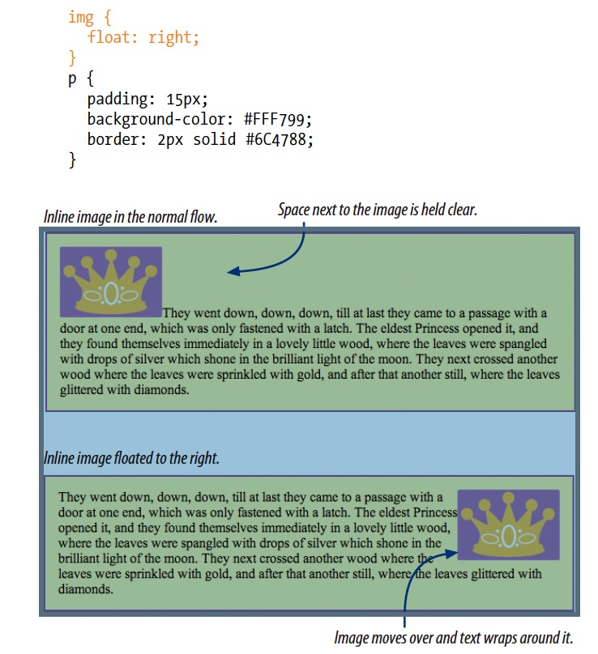
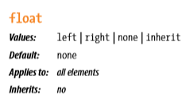

Float
Moves element as far as possible to right or left allowing following content to wrap around it.
Notes:
Edit floatStart.html to change position of image

Slide 7
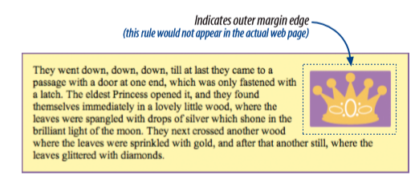
What code would generate the following effect?
img { float: right; margin: 10px; }
img { float: left; margin: 10px; }
None of the above
Notes:
A

Slide 8
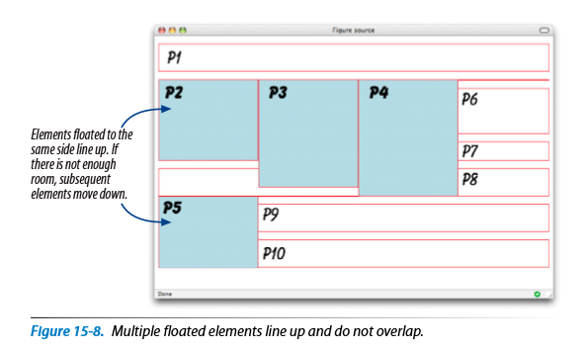

Slide 9
Things to remember about float
A floated element is like an island in a stream – the stream has to flow around it
Floats stay in the content area of the containing element
Margins are maintained
Notes:
Move the image outside of the p tags and take out style… show boxes… draw boxes for when it is in the p tag

Slide 10
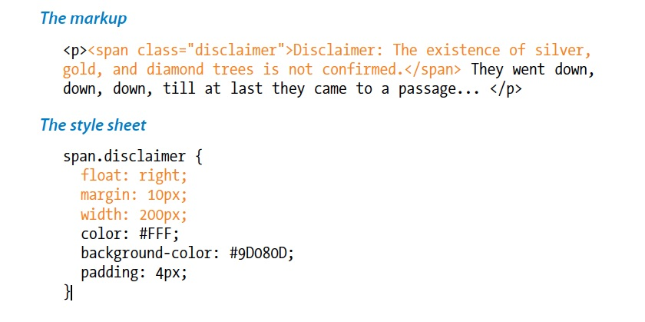
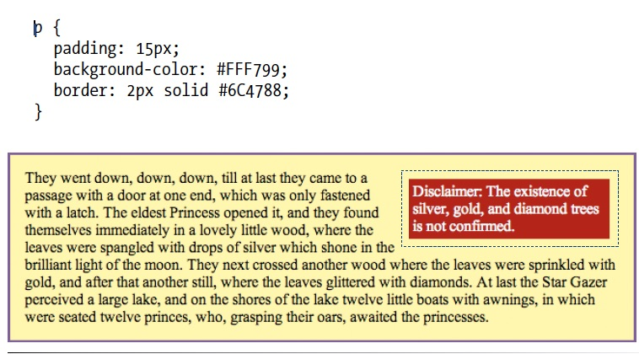
Floating non-images
Always provide a width for floated elements
Floated inline elements behave as block elements
Margins on floated elements do not collapse
Notes:
demo this

Slide 11
Always provide a width for floated text elements
Normal flow, abutting top and bottom margins collapse (overlap), but for floated elements, the margins are maintained on all sides as specified.

Slide 12
How do you turn Floating off??
Turn off to get back to layout as usual
Use the attribute clear:
p {
clear: left;
}
Notes:
show paddingMargins.html, margins.html

Slide 13
using floats to create columns
For 2-column layout, you can do:
Float one div and add a wide margin on the side of the text element that wraps around it
Float both divs to the left or right
Float one div to the left and the second div to the right
Need to be sure that every float has a specified width
Total width of all columns (don’t forget padding, borders and margins) cannot exceed the width of the browser
Notes:
Add main and side content to file and show the different widths
Show adding columns… show difference between floating left and floating right with placement of sections

Slide 14
positioning
Two types:
relative
moves the box relative to original position
space the element would have occupied in the normal flow is preserved as an empty space
absolute
elements are removed from normal flow
positioned with respect to the browser window or a containing element

Slide 15
How to specify position
Provide values for each of the offset properties representing the distance the element should be moved away from that respective edge.
top
left
bottom
right

Slide 16
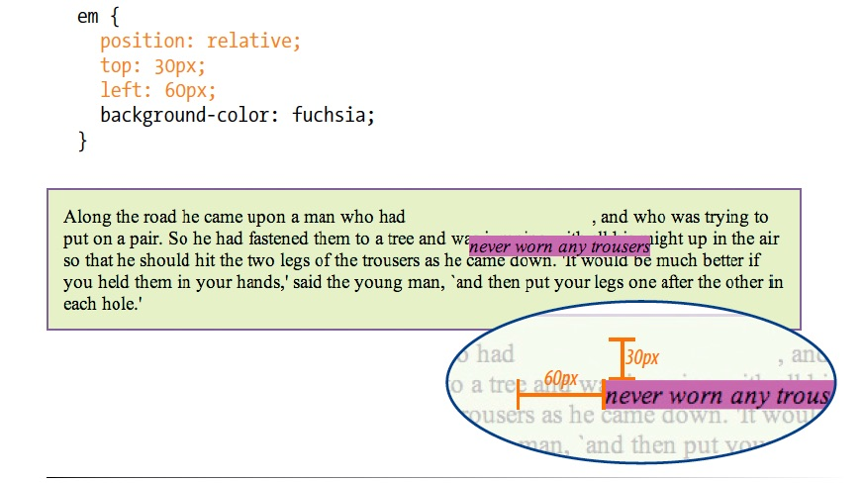
Relative positioning

Slide 17
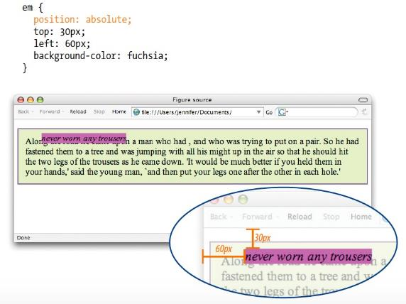

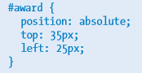
Absolute positioning
Notes:
Absolute positioning is that the element is positioned relative to its nearest containing block
show positioning.html

Slide 18
Which of the following is not true of floated elements?
All floated elements behave as block elements.
Floats are positioned against the padding edge of the containing element.
The contents of inline elements flow around a float, but the element box is unchanged.
You must provide a width property for floated block elements.
Notes:
B is not true. Floats are positioned against the content edge, not the padding edge.

Slide 19
B is not true
Floats are positioned against the content edge, not the padding edge.

Slide 20
Which of these style rules is incorrect?
img {
float: left;
margin: 20px;
}
img {
float: right;
width: 120px;
height: 80px;
}
img {
float: right;
right: 30px;
}
img {
float: left;
margin-bottom: 2em;
}
Notes:
c is incorrect. Floats do not use offset properties, so there is no reason to include right.

Slide 21
C is incorrect
Floats do not use offset properties, so there is no reason to include right.

Slide 22
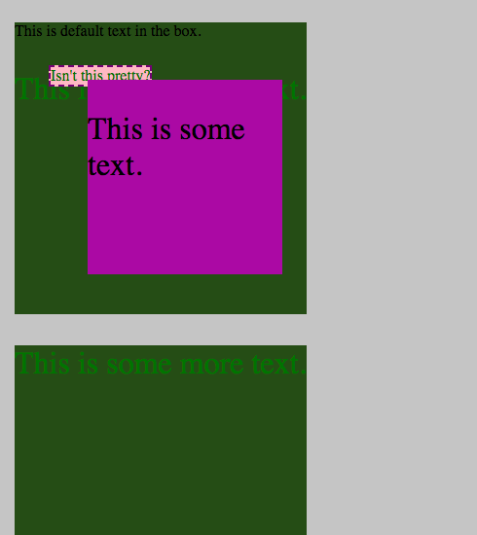
Demo

